Slide 1
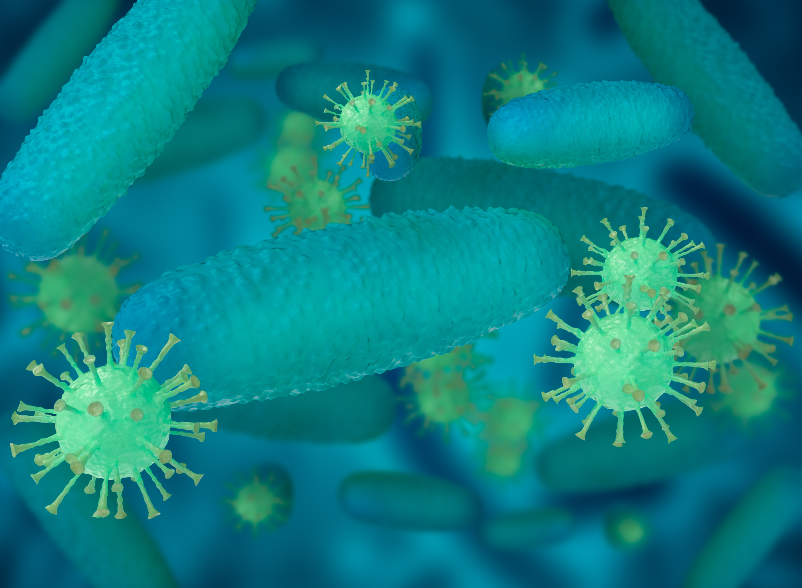
SCREENING LABORATORY, INSTITUTE OF MEDICAL BIOLOGY PAS
The IMB PAS Screening Laboratory offers research in the field of antiviral activity of chemical compounds.
The Screening Laboratory operates according to the standards of Biosafety Level 2 (BSL-2).
Human viral strains:
Human herpesvirus 5 (ATCC, HCMV, VR-977), genetic material – DNA
Human parainfluenza virus 3 (ATCC, HPIV-3, VR-93) genetic material – RNA
Human herpes simplex virus 1 (ATCC, HSV-1, VR-539), genetic material – DNA
Human adenovirus 5 (ATCC, ADV5, VR-5), genetic material – DNA
Human rhinovirus 8 (ATCC, HRV8, VR-488), genetic material – RNA
Animal viral strains:
Encephalomyocarditis virus (ATCC, VR-1763), genetic material – RNA
Contact:
Agnieszka Olejniczak, PhD. DSc.
aolejniczak@cbm.pan.pl
+48-42-272-36-37
The biological material has been obtained from ATCC (American Type Culture Collection).
MTT colorimetric assay and real-time cell analysis (RTCA) are used to assess cytotoxicity
and antiviral activity against held cancer cell lines, normal cells and viral strains.

